Slide 1


Genomska informatika: zadatak 4
Student: Aleksandra Todorović 2022/3090
Aleksa Marušić 2021/3314
Jun 2023

Slide 2
Challenge description
What is cell annotation refinement?
Machine learning models
Number of features
Samples given
Mouse embryo 9.5
Mouse brain

Slide 3
Input data
Mouse embryo
5 913 cells
25 568 genes
12 Classes
“Unknown”?
Mouse brain
50 140 cells
25 879 genes
29 classes

Slide 4
Approaching the task
Preprocessing the data
Selecting best features
Number of features to take?
Stratified-by-K-fold-Splits
Number of splits?
Choice of training model?
Lower limit for L?
Presenting results

Slide 5
Data preprocessing
Filter cells with less than 200 genes
Filter genes found in less than 3 cells
Remove “Unknown” class
Data normalization
Remove mt- genes?
Remove ribo-genes?
Doublet removal?

Slide 6
Feature selection
Add spatial coordinates to features that are used
Multiple methods
Umap
PCA
Kbest
Kbest choose number of features
10, 20, 50, 100

Slide 7
Cross validation
KFoldSplits
Stratified-by-annotation?
Number of folds
3, 5, 7, 10
L?
Upper 0.35*k

Slide 8
Training model
SGDClassfier
RandomForest – has its own feature selection
Knn – already uses distance as a variable

Slide 9
Getting the results
Using train set as output?
Plotting results

Slide 10
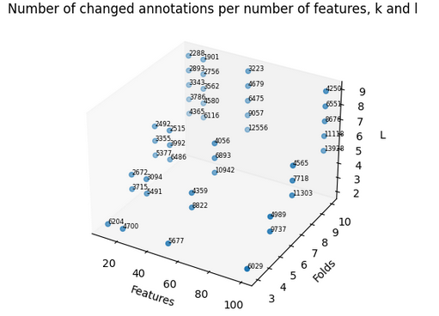
Mouse brain results

Slide 11
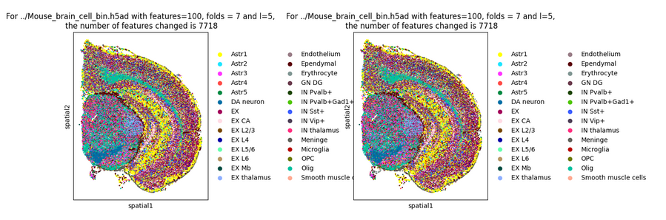
Mouse brain results

Slide 12
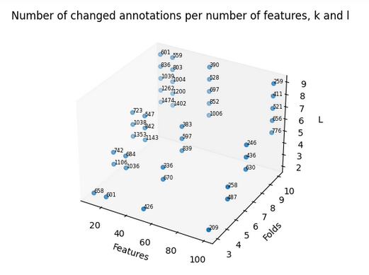
Mouse embryo results

Slide 13
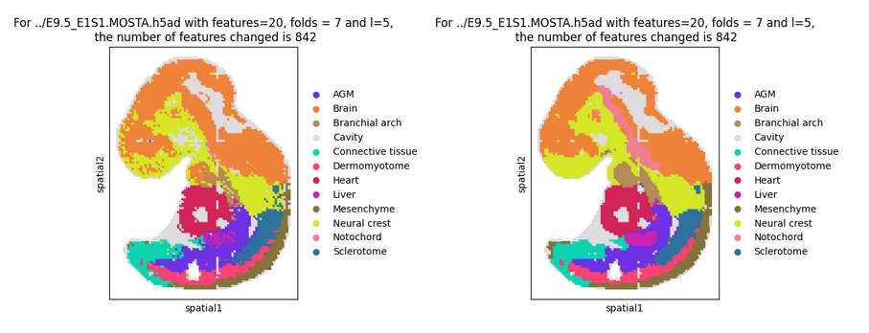
Mouse embryo results

Slide 14
Thank you!
Questions?
Github: https://github.com/Aleks1706/gi2023_project/

